Slide 1


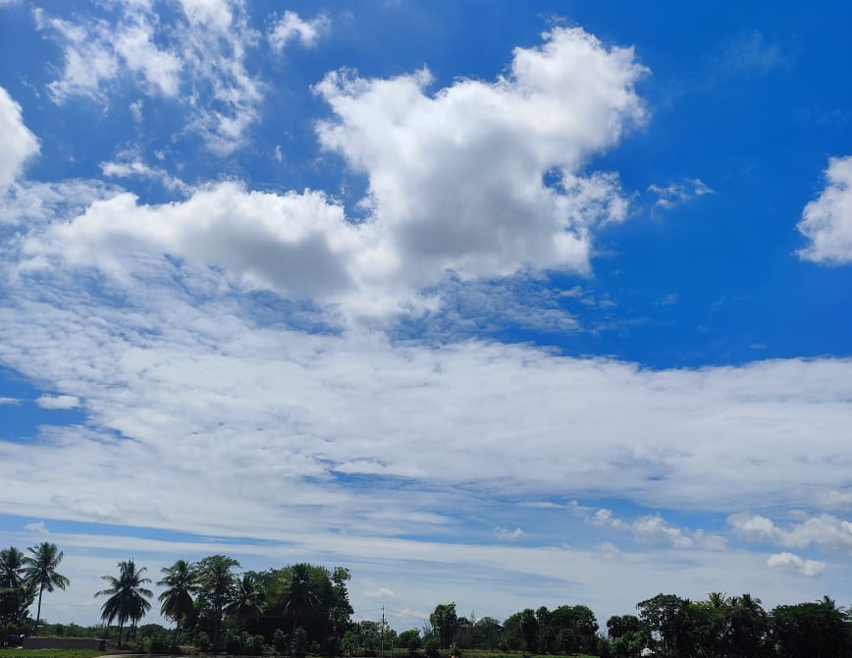

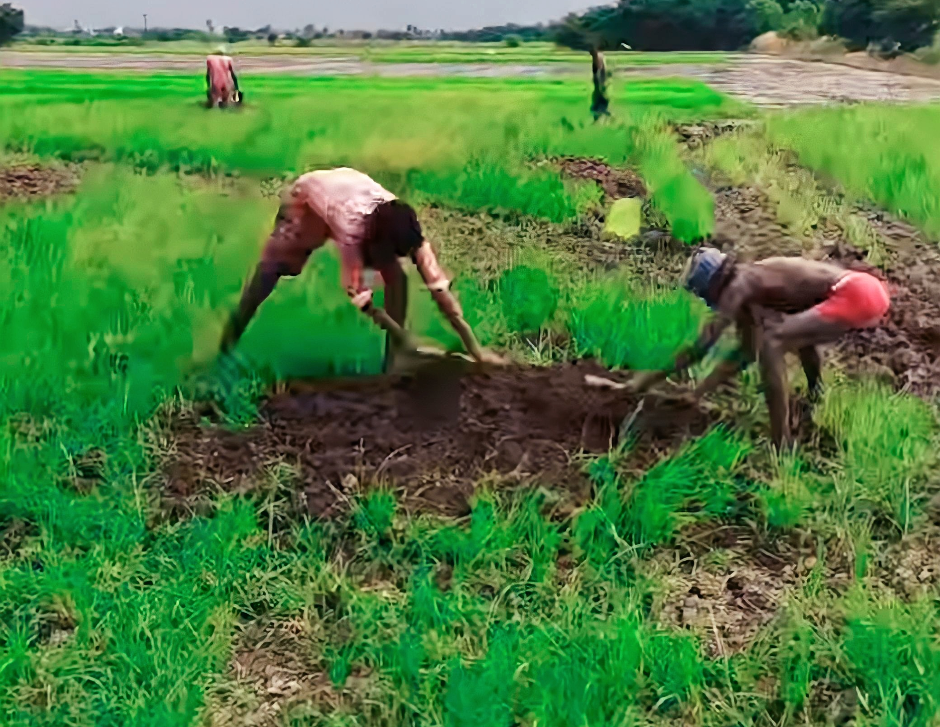
INDIAN AGRICULTURAL CROP PRODUCTION ANALYSIS (1997-2021)
TEAM
DHARANI RAVI
M.DHARANI
H.DURGA
M.DURGA

Slide 2
INDIAN AGRICULTURAL CROP PRODUCTION ANALYSIS (1997-2021)
OVERVIEW :
Indian Agricultural has long old and beyond memory history which begins the individually civilization.
India's economy has progressively declined to less than 15% due to the high growth rates of the industrial and services sectors.

Slide 3
PURPOSE
Indian economy is mostly agricultural based economy and highly dependent on agriculture for production, distribution, and also consumption.
Agriculture plays a very crucial role in international trade as well as import and export.

Slide 4

EMPATHY MAP
Problem Definition
z

Slide 5
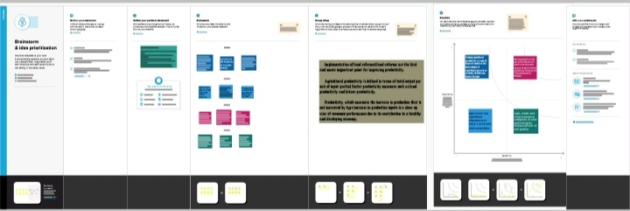
IDEATION AND BRAINSTORMING
z

Slide 6
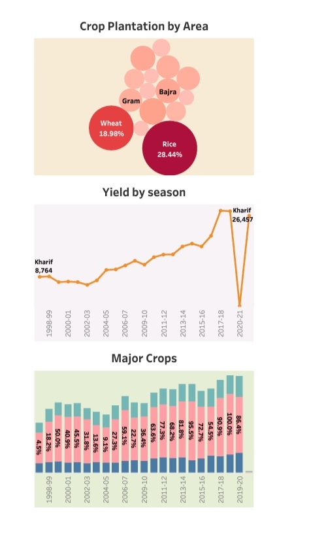
RESULT
z
Area occupied by plantation crops in India = 4 million ha. = 2.8% of total cropped area.
Indian Agricultural yield per Hectare: Gram data was reported at 973.000 kg/ha in 2017.
Major crops grown in India are rice. Wheat, millets, pulses, tea, coffee, sugarcane. Oil seeds. Cotton and juice.

Slide 7
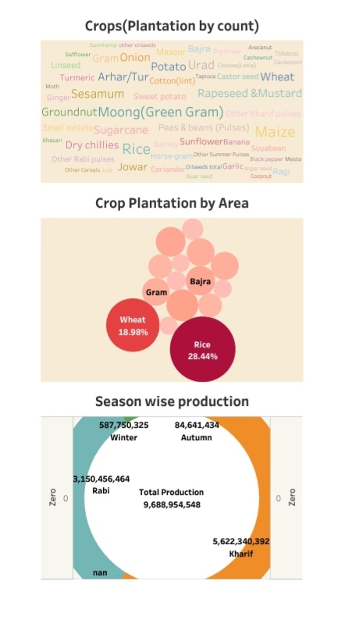
RESULT
India is the world's largest producer of milk, Pulses, and jute. And ranks as the second-largest producer of rice, wheat, sugarcane, groundnut, vegetables, fruit. And cotton.
Area occupied by plantation crops in India=4 million ha.=2.8% of total cropped area.

Slide 8
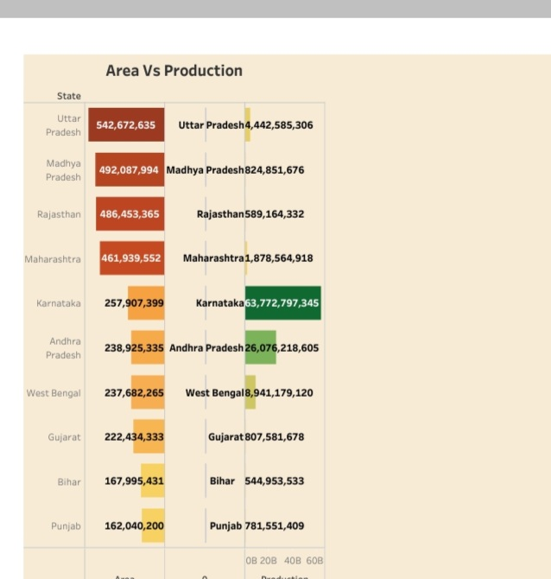
Area Vs Production
z

Slide 9
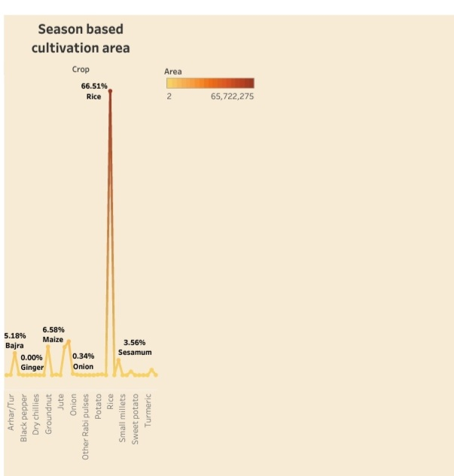
Season based cultivation area
z

Slide 10
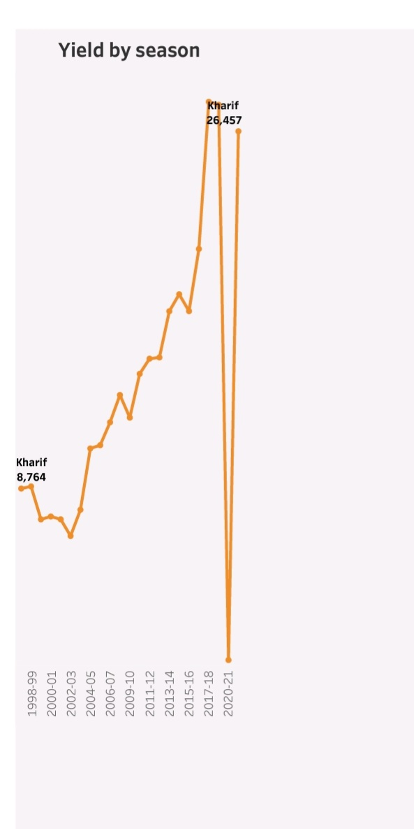
Yield by season
z

Slide 11
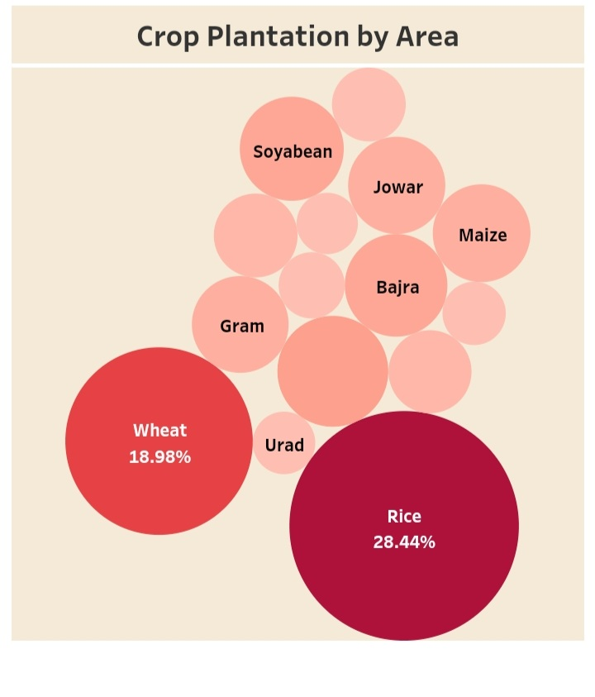
Crop Plantation by Area
z

Slide 12
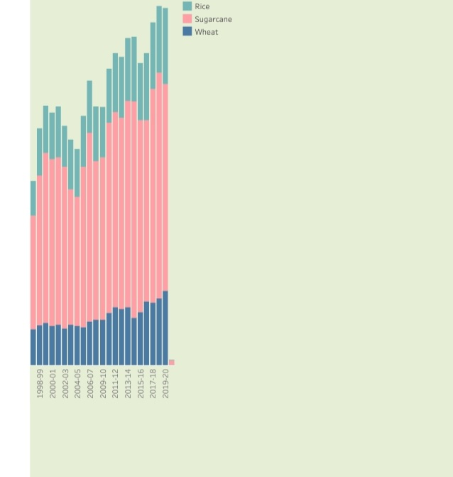
Major Crops
z

Slide 13
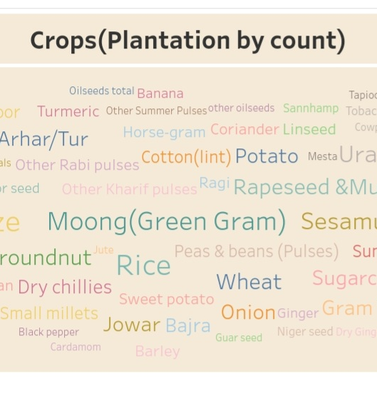
Crops(Plantation by count)
z

Slide 14
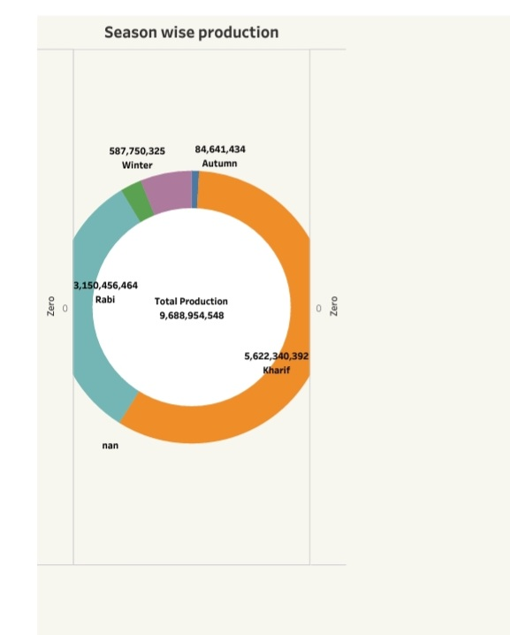
Season wise Production
z

Slide 15
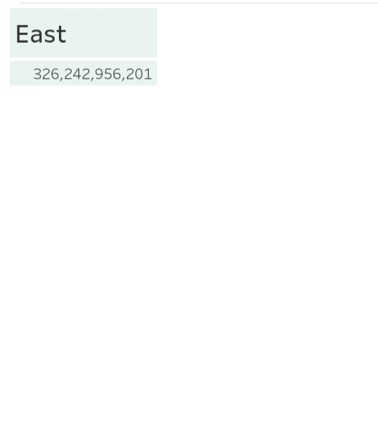
Kpi's
z

Slide 16
INDIAN AGRICULTURAL CROP PRODUCTION ANALYSIS (1997-2021)
Advantages
Disadvantages
It improves soil structure, percolation and reduce change of creation of hard. pan in sub soil and also reduces soil erosion.
Farmers get a better price for his produce due to higher demand in local market. so there is regular flow of income over year.
Financial risk results when the farm business borrows money and creates an obligation to repay.
Five general types of risk described there:
Production risk, price or market risk, financial risk, institutional risk, and human or personal risk.

Slide 17
Applications
Agriculture analysis is a very important aspect to crop growing. To increase quality and yields.
Increasing crop yields is a high priority for growers.
Market for industrial products.
Contribution to capital formation.
Largest employment providing sector.
Our floor scene spectroscopy instruments can be advantageous to help predict current yield factors.

Slide 18
Conclusion
Indian agriculture forms the back bone of Indian economy and despite concerted industrialization in the last six decades, agriculture occupies a place of pride.
Indian agriculture needs shift itself form traditional approach to scientific approach.
Indian agriculture needs to adapt technological and research oriented environment instead of struggling in traditional and superstitious environment.

Slide 19
Future Scope
Employment opportunities are provided by agriculture as well as non-agricultural activities.
Agriculture plays a very crucial role in international trades as well as import and export.
Agriculture is key in all economies no matter what their degree of advancement.
Farmer get a better price for his produce due to higher demand in local market.

Slide 20
Thank you
z

